Slide 1


SMART INDIA HACKATHON 2024
WOMEN SAFETY ANALYTICS PROTECTING FROM SAFETY THREATS
Problem Statement ID –SIH1605
Problem Statement Title- Women safety analytics protecting women from safety threats.
Theme- To protect women and girls from every situations in our society (like molestation and any other types of problems etc…..)
PS Category- Software
Team ID-
Team Name – PSEUDO PROGRAM NERDS

Slide 2
IDEA TITLE
WOMEN
SAFTEY
Proposed Solution (Women Safety Analytics-Protecting Women From Safety Threats.
Overview About The App - The women’s security app is designed to entance personal safety for women by providing real-time emergency assistance, movement tracking and quick access to crucial contact.
Features -:
Gyroscope integration- Monitors and Tracks user movements, detecting unusual patters on signs .
SOS System- Allow users to send immediate messages and signals with their current location to predefined emergency contacts , police station and medical services.
Emergency Contact Management- Users can share and manage important phone numbers directly with in the app.
User Friendly Interface- Displays key features like quick access to emergency contacts.
Innovation- Utilizing a gyroscope to monitor and analyses movement patterns and allow the app to detect abnormal activity. This add an additive layer of real time safety monitor.
The SOS system provides user with a guide and efficient way to alert emergency contacts and services.
* Storing And Managing - Combining Gyroscope data with SOS alerts creates a protactive safety solution that not only responds to emergencies but also monitors for potential risks before they escalate.

Slide 3
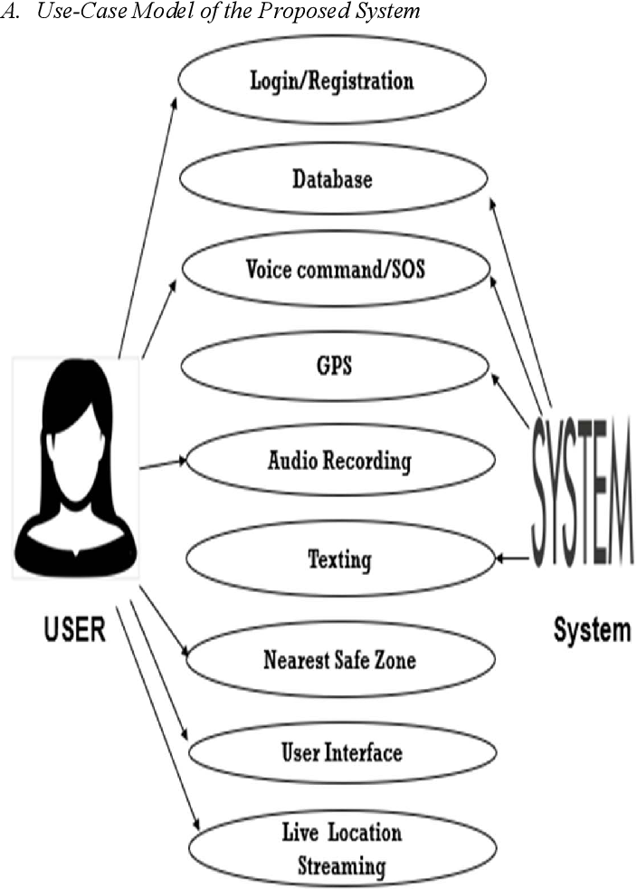
TECHNICAL APPROACH
WOMEN
SAFTEY
PROGRAMMING LANGUAGE -
FLUTTER , JAVASCRIPT , CSS , HTML , REACT JS
SOFTWARE TOOLS HARDWARE TOOLS IDES CROSS-PLATFORM FRAME WORK # GYROSCOPE API TESTING # SOS DESIGN TOOLS(CI/CD)

Slide 4
FEASIBILITY AND VIABILITY
WOMEN
SAFTEY
FEASIBILITY OF THE IDEA
Feasible with existing frameworks and APIs for cross platform development and real-time functionalities with uses of sensors.
Development is achievable with available tools and expertise. Through it which
requires investment of time and resources.
POTENTIAL CHALLENGE AND RISK
Potential challenges includes ensuring robust security and privacy for sensitive user data .
Risks involve techniques , issues with real time features and competition from established safety apps.
STRATERGIES FOR OVERCOMING CHALLENGES
Use encryption, secure authentication and regular security audits to protect user data .
Conduct extensive testing for real time features and continuously refine the app based on user feedback and performances metrics .

Slide 5
IMPACT AND BENEFITS
WOMEN
SAFTEY
POTENTIAL IMPACT ON TARGET AUDIENCE
Provides users with real-time alerts and quick access to emergency help, improving personal security.
Raise’s awareness about personal safety and offers a practical tool that is easily accessible in emergency situation.
BENEFITS
Immediate assistance quick SOS alerts and real-time location sharing enhances emergency response.
Fall Detection- Gyroscope integration detects falls on unusual movements promoting immediate action.
Customizable Alerts- Users can configure emergency contacts and message content for tailored response.
User Empowerment- Provides a sense of security and control, boosting confidence in personal safety.

Slide 6
RESEARCH AND REFERENCES
WOMEN
SAFTEY
RESEARCH AND REFRENCES WOMEN SAFETY TECHNOLOGIES
SAFETY OF WOMEN IN INDIA-https://timesofindia.indiatimes.com/blogs/the-next-step/safety-tips-for-women/
ABOUT WOMEN SAFETY APP-https://timesofindia.indiatimes.com/7-best-women-safety-apps/photostory/51285556.cms
SENSOR TECHNOLOGIES
GYROSCOPE-https://www.elprocus.com/gyroscope-sensor/
SOS-https://sostechnologiesinc.com/index.html
TRACKING DEVICE-https://support.google.com/earth/answer/148095?hl=en

